Slide 1
Respiratory System
Dr Archna Ghildiyal
Associate Professor
Deptt of physiology
KGMU

Slide 2
LECTURE :2
Contents
Mechanics of Pulmonary Ventilation
-Role of muscles
-Role of ribs
-Pressure changes (Alveolar,
Pleural &Transpulmonary)

Slide 3
Learning Objectives
Terms-Breathing, Ventilation,External & Internal Respiration,
Muscles of Inspiration & Expiration
Pressure & volume changes during respiratory cycle

Slide 4
Mechanics
Lungs are contracted or expanded in 2 ways:
Downward and upward movement of diaphragm (major force during normal, quiet breathing.
Elevation and depression of the ribs, using abdominal and rib cage (intercostal) muscles.

Slide 5
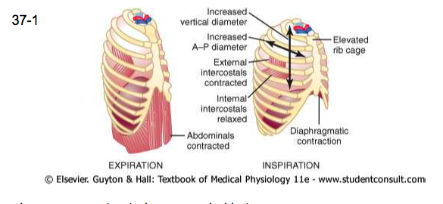
Contraction and Expansion of the Thoracic Cage

Slide 6
Diaphragm
Divides Chest/Abdomen
75% of gas movement
1.5cm movement during
quiet breathing
Inspiration -contraction
Expiration - relaxation
-Elastic Recoil

Slide 7
Inspiration
Diaphragm contracts and moves down
Rib cage is pulled upward and expanded

Slide 8
Inspiratory Muscles
1.Diaphragm
2.External Intercostal muscles
Accessory Inspiratory muscles :
1.Sternocleidomastoid
2.Anterior serrati
3.Scaleni
4.Alae nasi

Slide 9
Expiration
Diaphragm relaxes and moves up
Rib cage is pulled downward
Chest wall and abdominal structures compress the lungs.

Slide 10
Recoiling of lungs during Expiration
Elastic connective tissue in the lungs
Alveolar surface tension(Surfactant Reduces the Alveolar Surface Tension )
Elastic forces affect Lung Compliance

Slide 11
Expiratory Muscles (Hyperventilation)
1.Rectus abdomonis
2.Internal intercostal
3.Internal 7 external obliques
4.Transversus abdominis

Slide 12
Role of Respiratory Center
Inspiration
Initate the stimuli for inspiration
Impulses are carried via nerves to the inspiratory muscles
Expiration
Terminate the
inspiratory impulses
Diaphragm (and /or inspiratory muscles relax

Slide 13
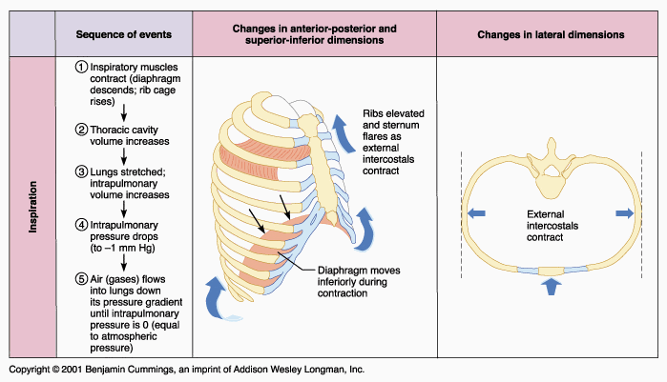

Slide 14
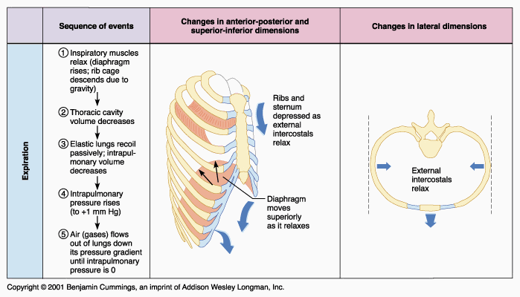

Slide 15
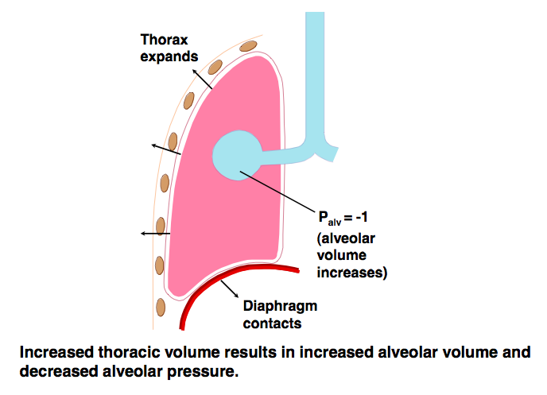
Boyle’s Law
At any constant temperature the pressure exerted by a gas varies inversely with the volume of the gas

Slide 16
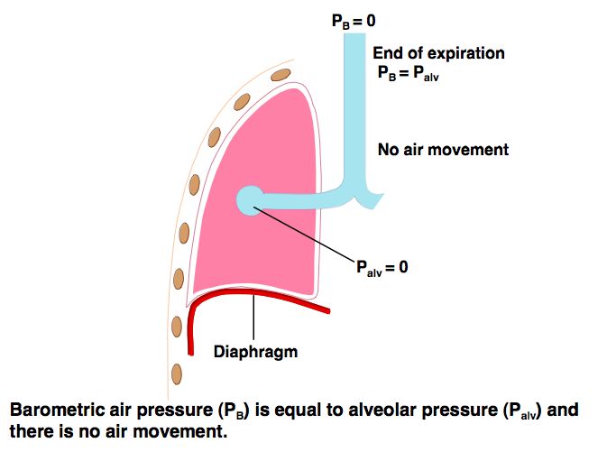
Pressure relative to atmosphere

Slide 17
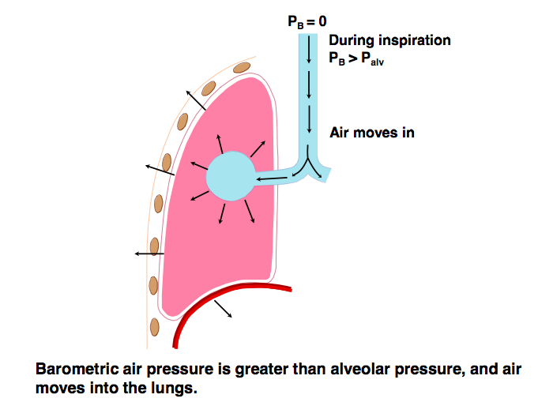
Barometric air pressure >alveolar Pressure

Slide 18
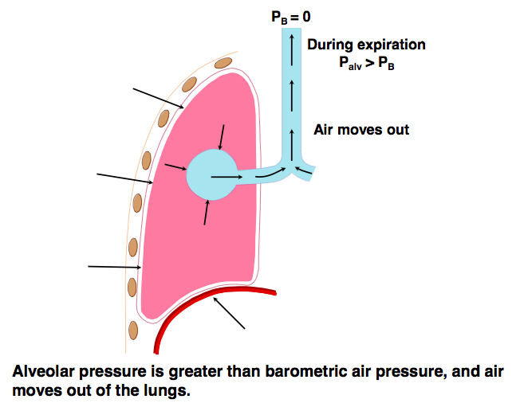
P_{alv} > P_{B}

Slide 19
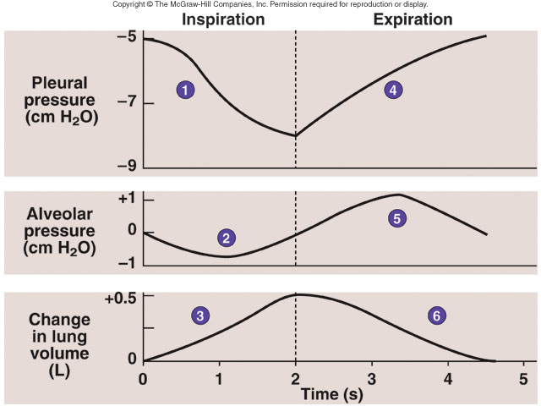
Normal Breathing Cycle

Slide 20
Normal values
1.Intra pleural Pressure:
at the beginning of inspiration: -5cm of water
At the end of inspiration: -7cm of water
2.Intra alveolar pressure( inside the lung alveoli): change during inspiration is 0 to -1cm of water
3.Change in lung volume: 0.5 Lt air into lungs
Trans pulmonary pressure=difference b/w Alveolar & Pleural pressure

Slide 21
Lung Compliance
Extent to which the lungs expand for each unit increase in transpulmonary pressure
Total compliance of both lungs together in normal adult: 200 ml of air per cm of water transpulmonary pressure (ie. 1cm of water increase in transpulmonary pressure will expand the lung volume by 200ml)

Slide 22
Applied
Atelectasis (lung collapse) commonly occurs when air enters the pleural cavity through a chest wound
Pneumothorax (air in the intrapleural space)
Guillain Barre syndrome (GBS) autoimmune disorder that affects the peripheral nervous system,Muscle weakness.

Slide 23
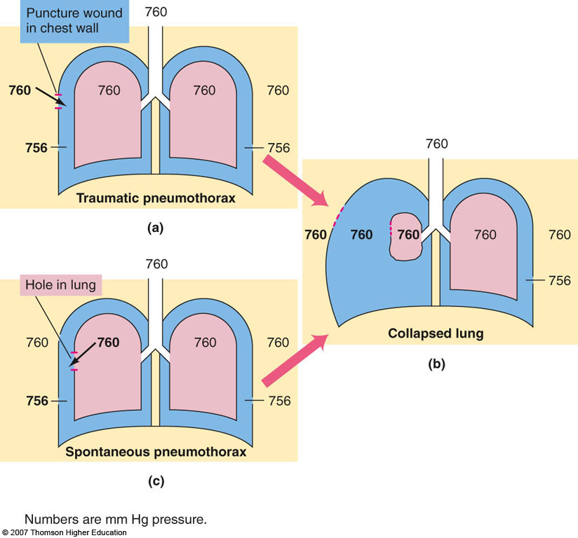
Pneumothorax (air in the pleural space) abolishes the transmural pressure gradient

Slide 24
References
Guyton & Hall.Text book of Medical Physiology
Ganong’s Review of Medical Physiology
Berne & Levy Physiology

Slide 25
Question:1
Which of the following does NOT happen during inspiration?
A.The ribs move upward
B.The diaphragm lifts up
C.The antero-posterior dimensions of
the chest are increased
D.The tranverse dimensions of the
thorax are increased

Slide 26
Question:2
Contraction of the abdominal muscles is important in
A. normal (quiet) inspiration B. forced (maximum) inspiration C. normal (quiet) expiration D. forced (maximum) expiration

Slide 27
Question:3
Which of the following represents the pressure difference that acts to distend the lungs?
A. Alveolar pressure B. Airway opening pressure C. Transthoracic pressure D. Transpulmonary pressure

Slide 28
Question:4
At the start of inspiration, how does alveolar pressure related to atmospheric pressure? A. Alveolar pressure is greater than
atmospheric. B. Alveolar pressure is less than
atmospheric. C. Alveolar pressure is the same as
atmospheric. D. Alveolar pressure is one of the few
pressures where the reference
pressure is not atmospheric.

Slide 29
Question:5
In which of the following conditions Respiratory muscles become weak:
A. Guillain-Barre syndrome
B. Emphysema
C. Asthma
D.Tuberculosis

Slide 30
Answers
1-B
2-D
3-D
4-B
5-A

